Slide 1
Risk & reward
4.3 Types of investment risk

Slide 2
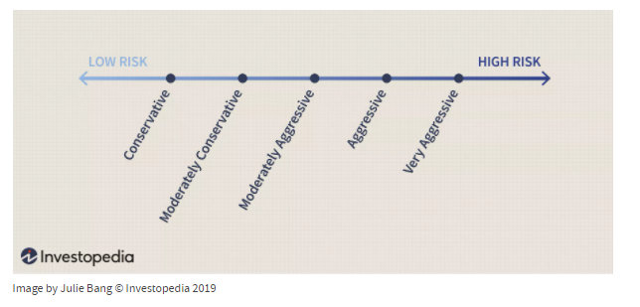
Achieve Optimal Asset Allocation

Slide 3
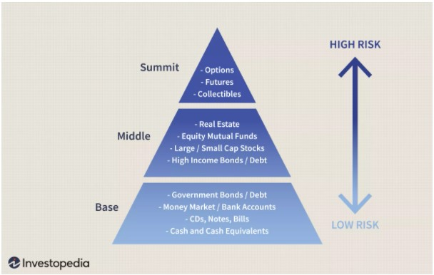
Determining Risk and the Risk Pyramid

Slide 4
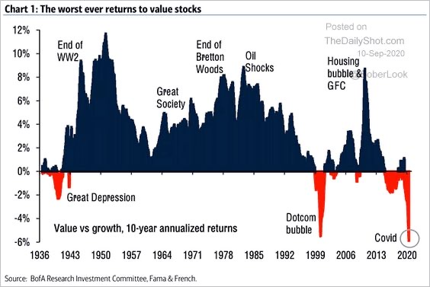
worst returns stock value
9 10 2020

