Slide 1
Native American Culture
In 2011, I was honored overwhelmed and surprised by my Native American Veterans when they made me an honorary warrior.
The Warrior Flag once in my classroom holds a place of honor in my home

Slide 2
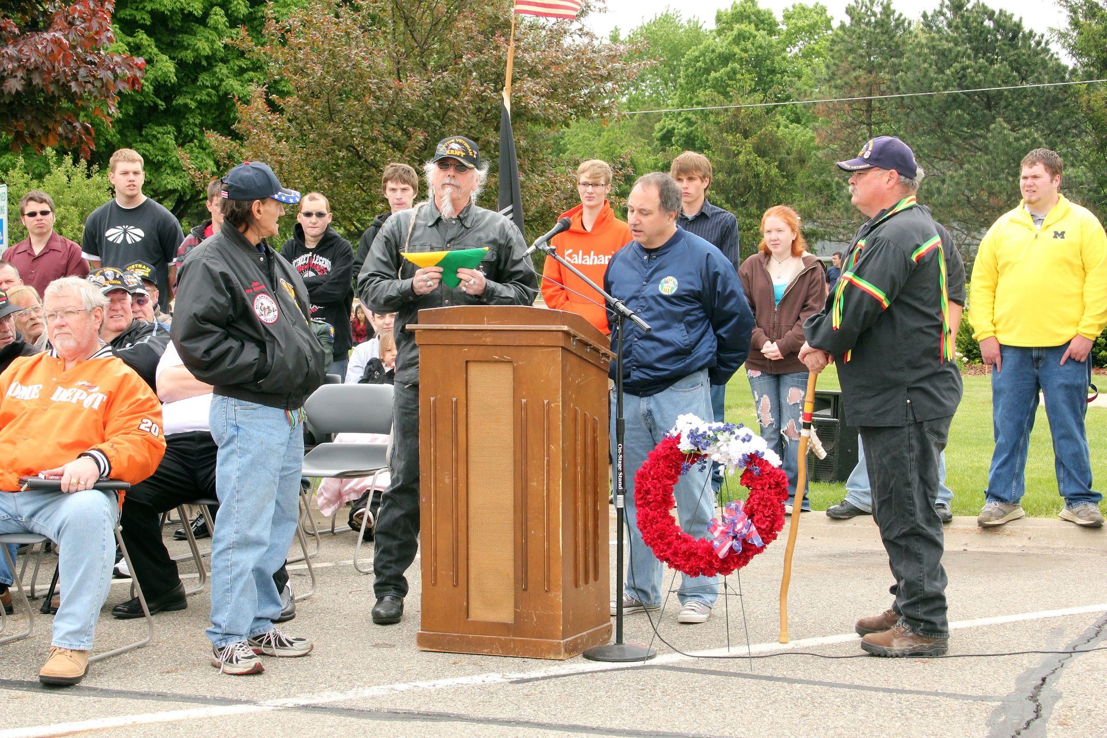

Slide 3
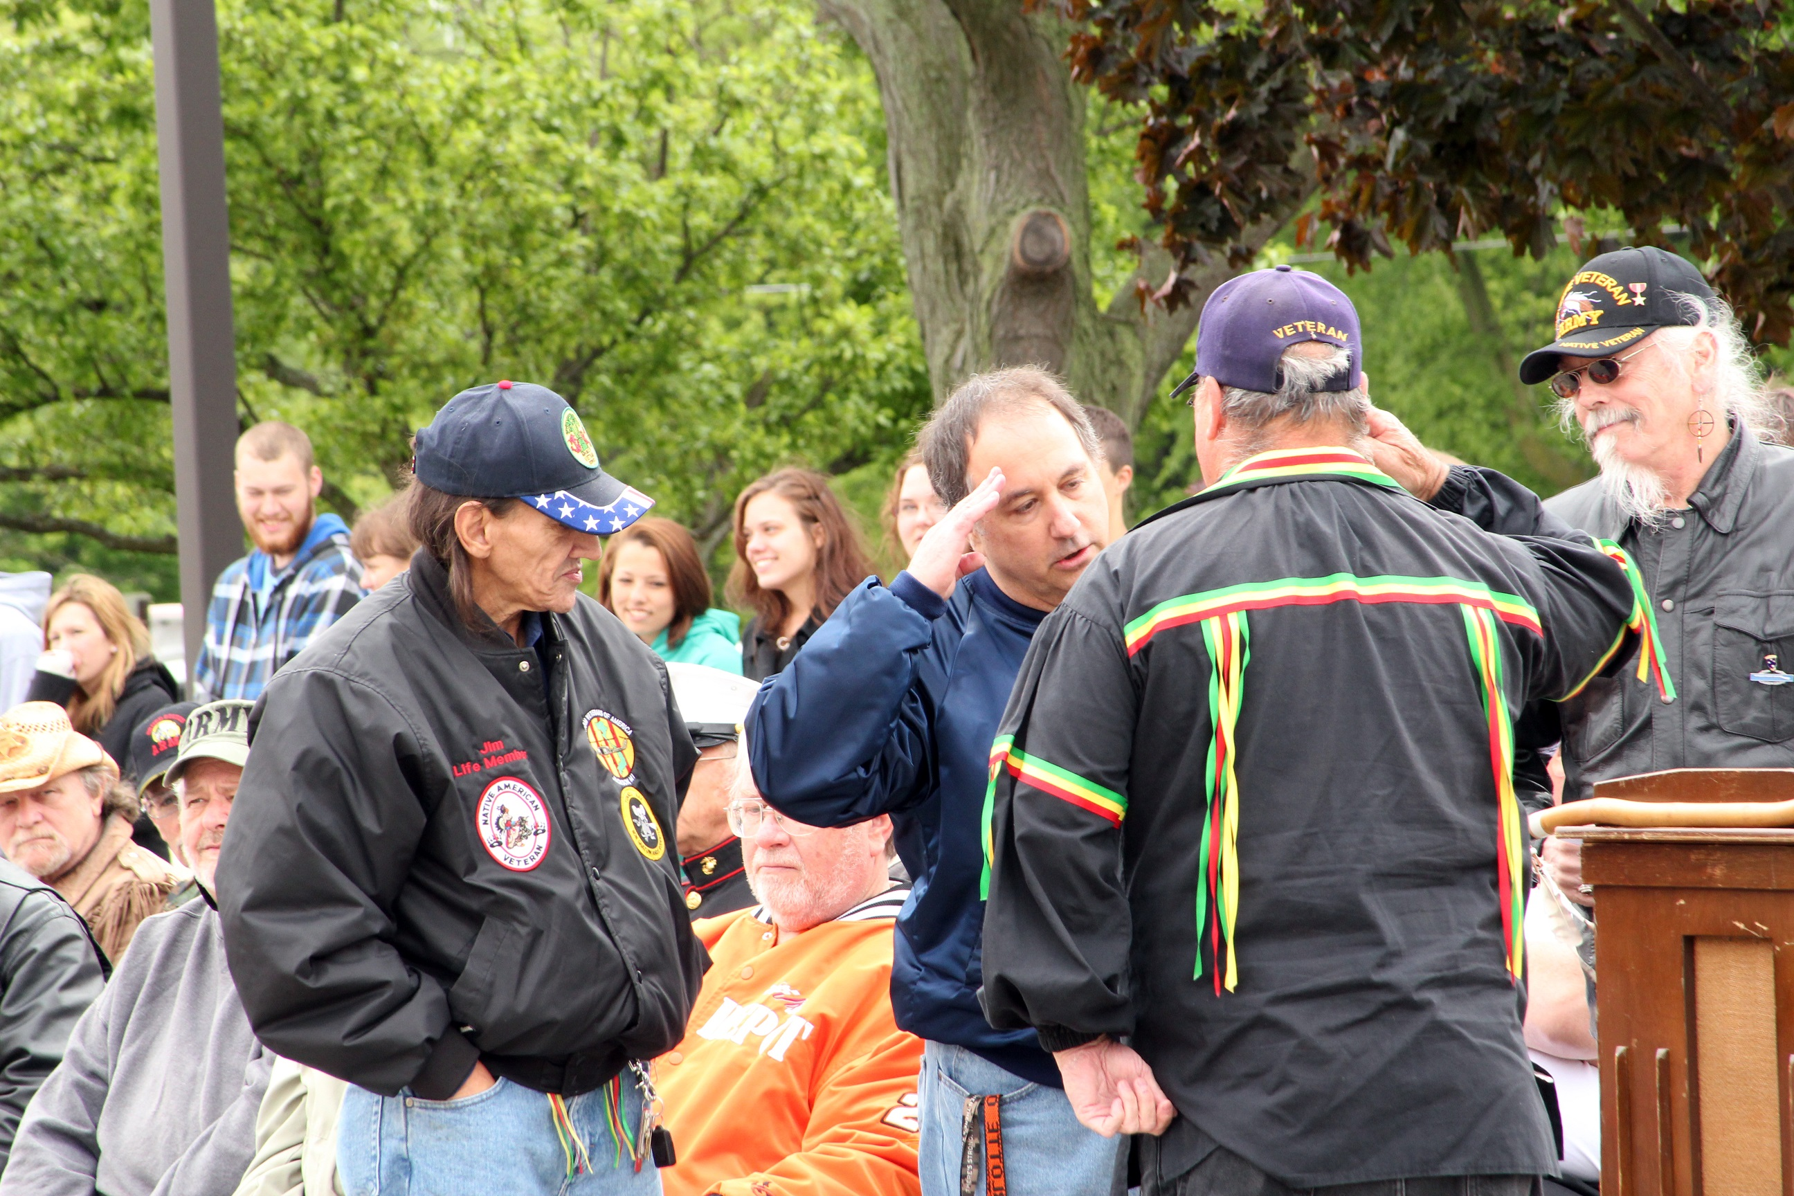

Slide 4
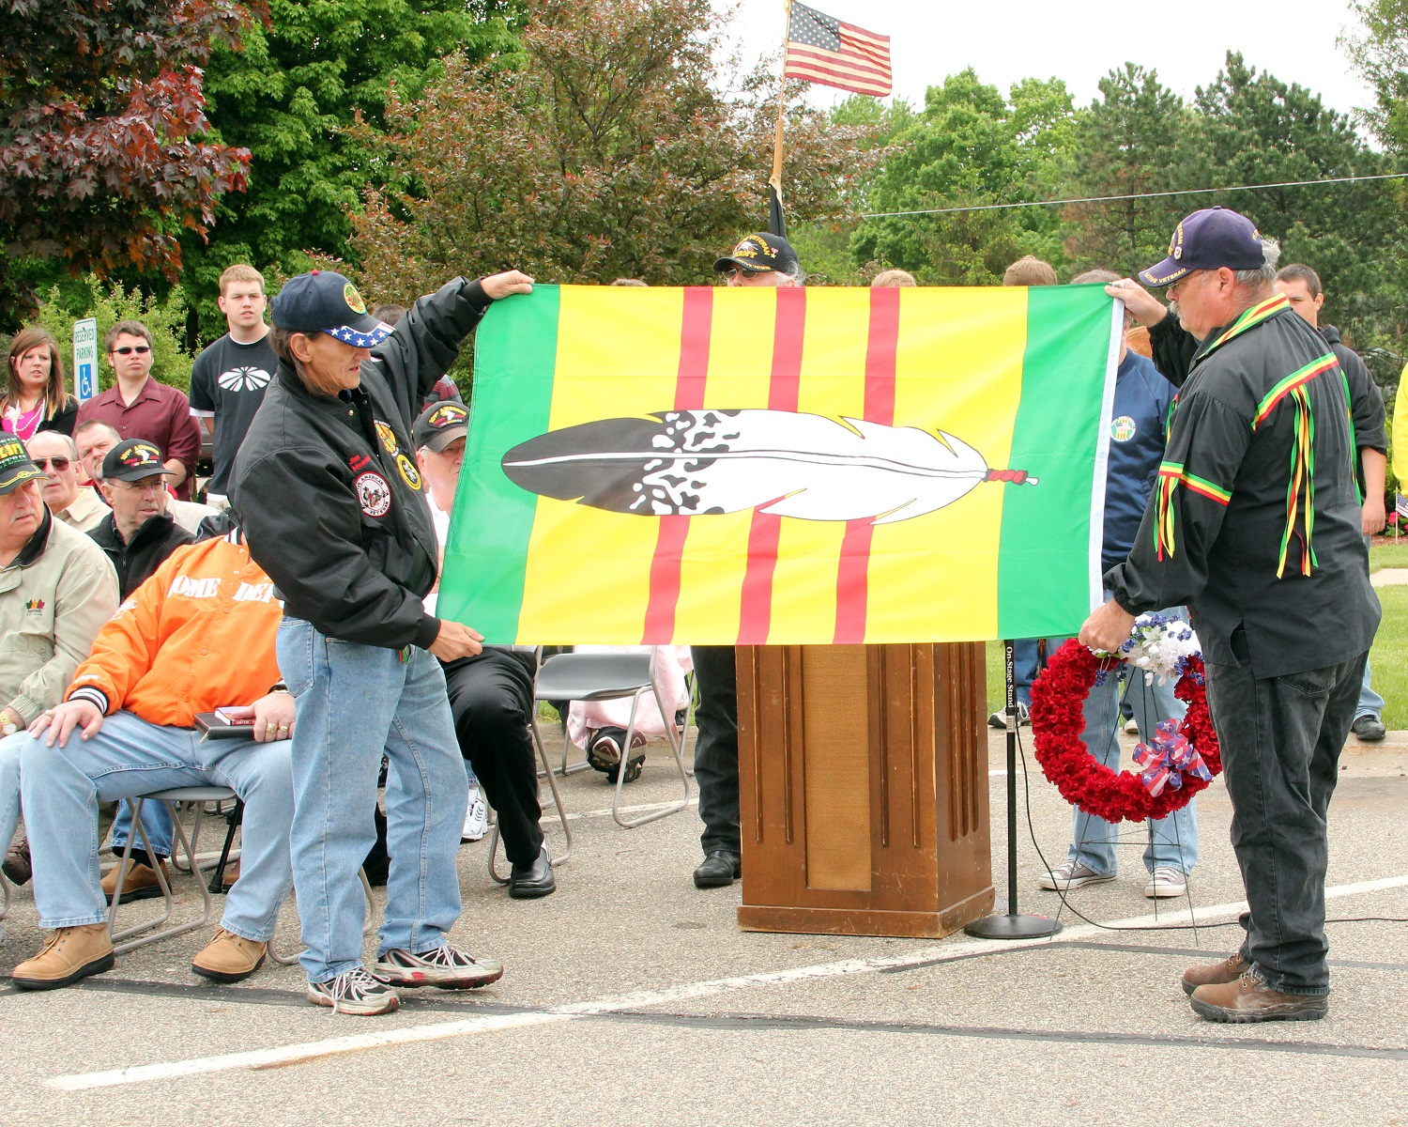

Slide 5
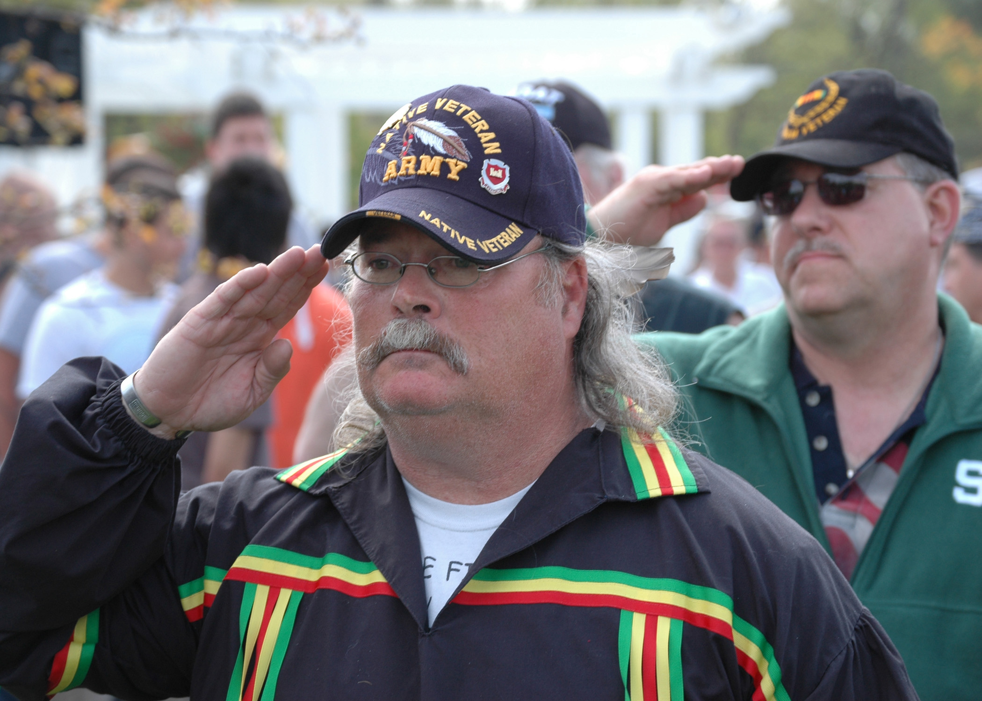

Slide 6
