Slide 1
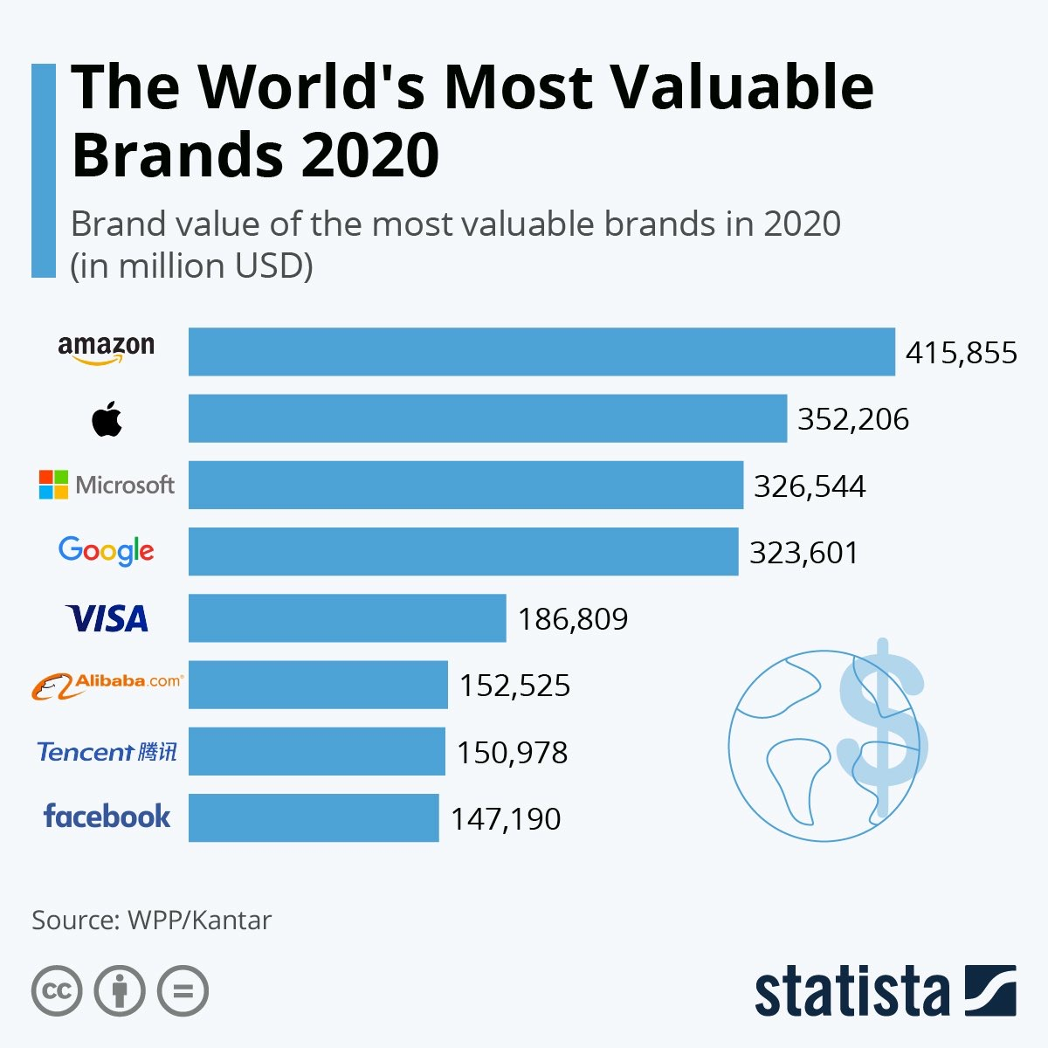
Large companies that people invest in

Slide 2
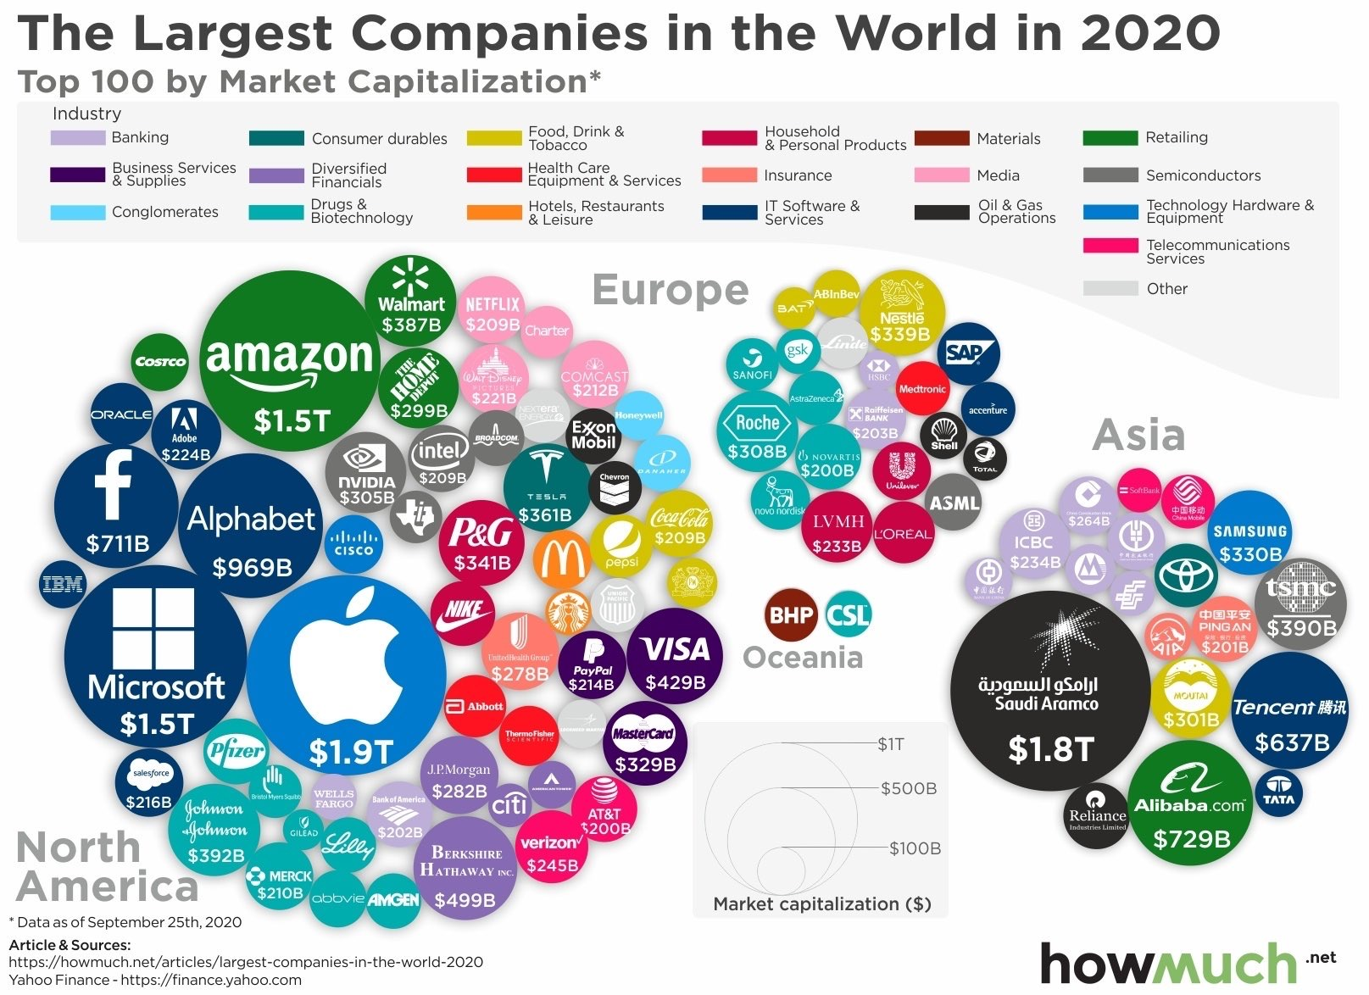
Large companies that people invest in

