Slide 1
Native American
Opening Ceremony of the Wall that Heals
Charlotte High School Charlotte, MI May 2008

Slide 2
Back Story
I spent over 30 years of my career as a social studies teacher honoring the Vietnam Veteran.
I felt since the age of nine that the Vietnam Veteran was not treated with respect when they returned to American soil after serving in one of our Nation’s most difficult wars. I had Vietnam Veterans come to the school to share their stories and experiences with our students for more than 30 years. One of my goals was to bring a replica of the Vietnam Veterans Memorial to my school to help educate my students and my community reflect on the sacrifices made by the Vietnam Veterans and their families. I also hope that it would help to honor my veterans and help them heal. During Memorial Day 2008, I was able to achieve that goal. More than 20,000 people attended the events that began with a motorcycle rally and ending with a multi denominational candlelight vigil. The opening ceremony was conducted by a group of Native Americans. I have added some other pictures just for context. This probably one of the single greatest achievements of my career. I had lots of help!
AND FOR THE RECORD I AM NOT A VETERAN
I WAS NOT THERE…BUT I CARE!

Slide 3
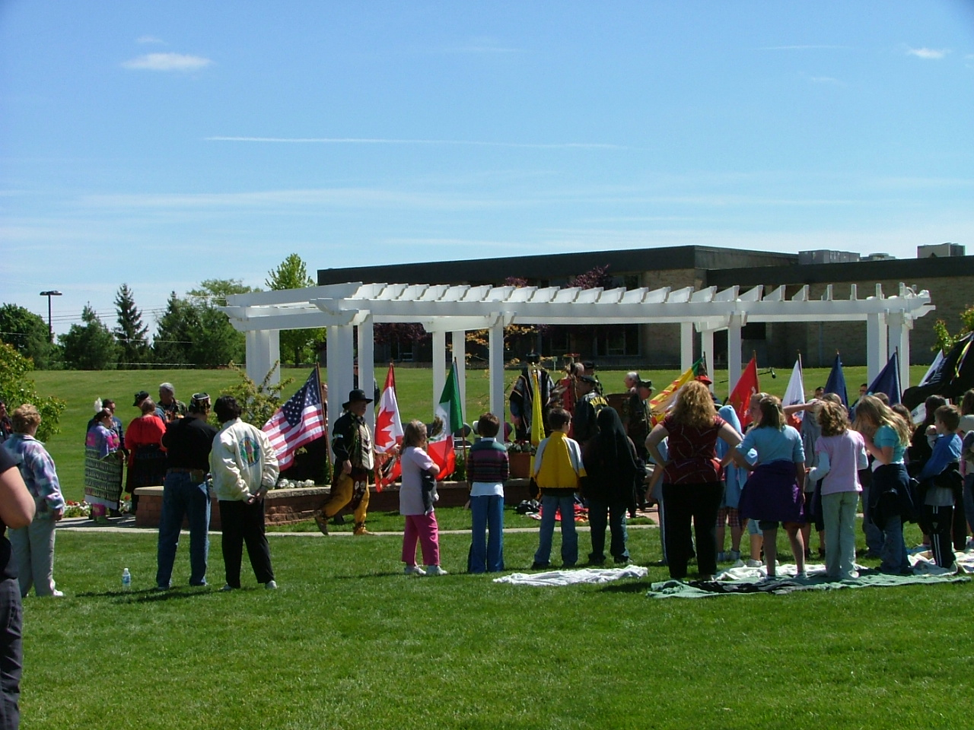
Native American opening ceremony for the Wall that Heals Charlotte, MI May 2008

Slide 4
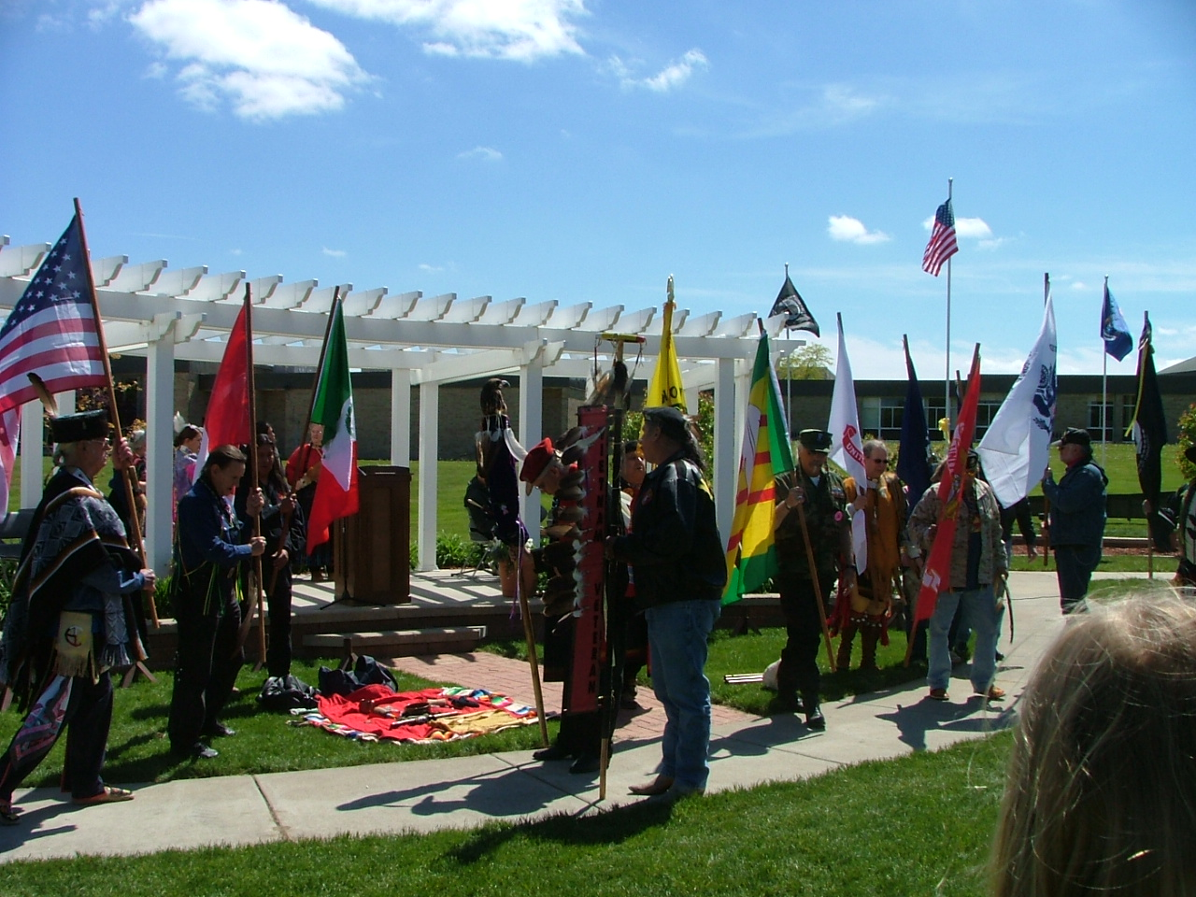
Native American opening ceremony for the Wall that Heals Charlotte, MI May 2008

Slide 5
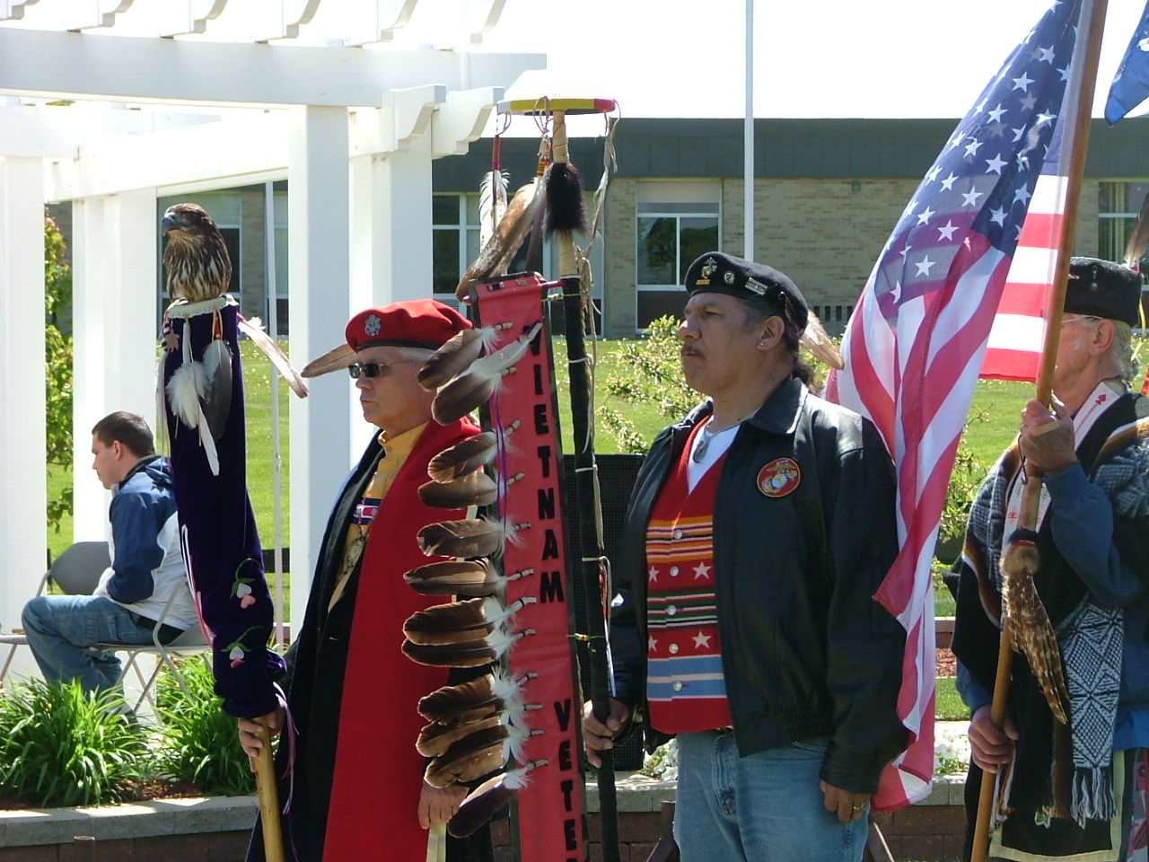
Native American opening ceremony for the Wall that Heals Charlotte, MI May 2008

Slide 6
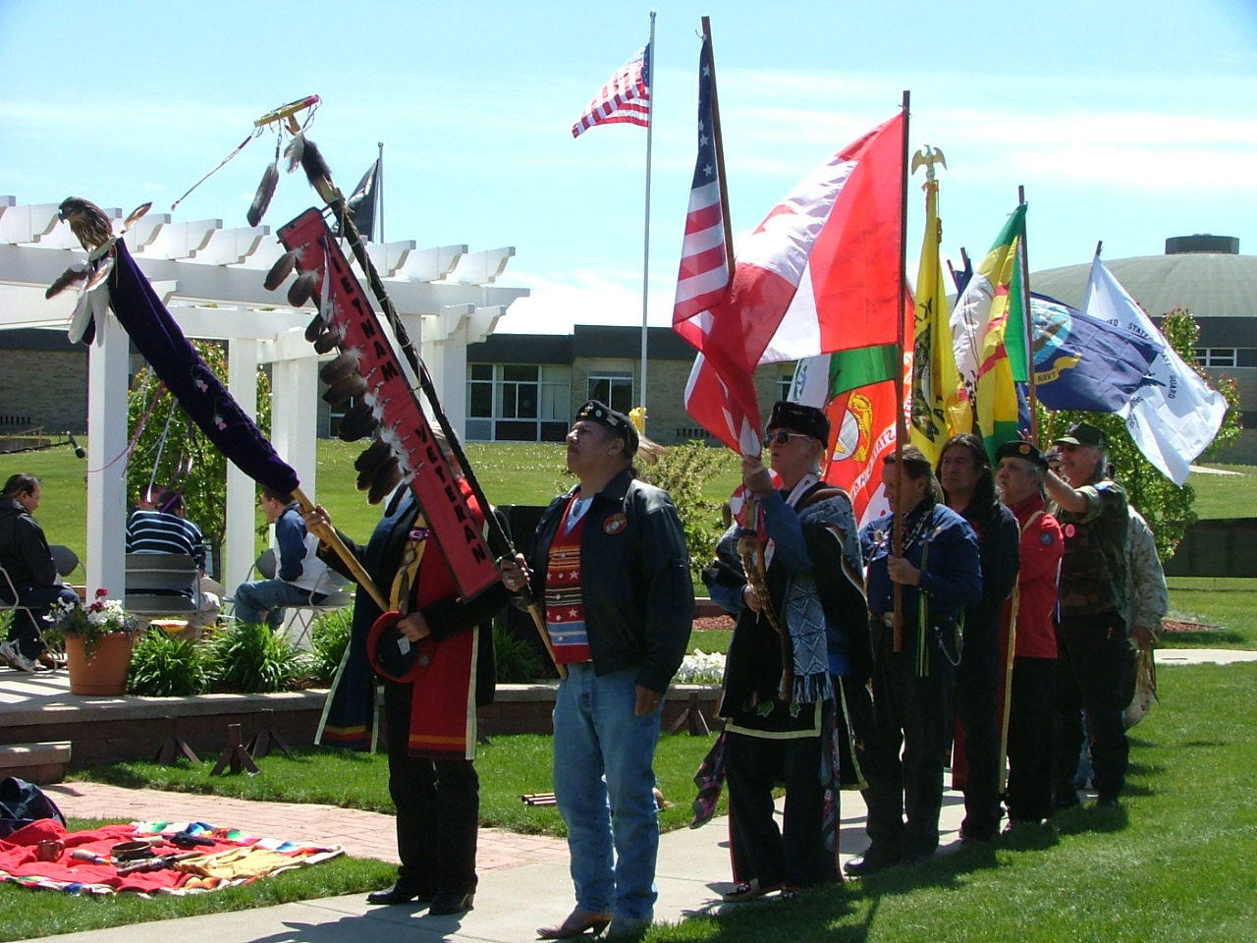
Native American opening ceremony for the Wall that Heals Charlotte, MI May 2008

Slide 7
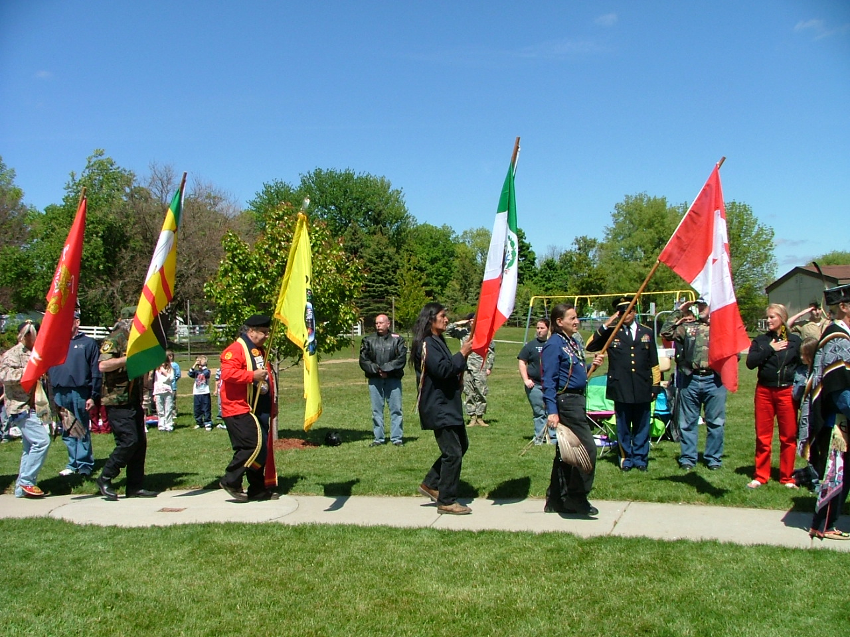
Native American opening ceremony for the Wall that Heals Charlotte, MI May 2008

Slide 8
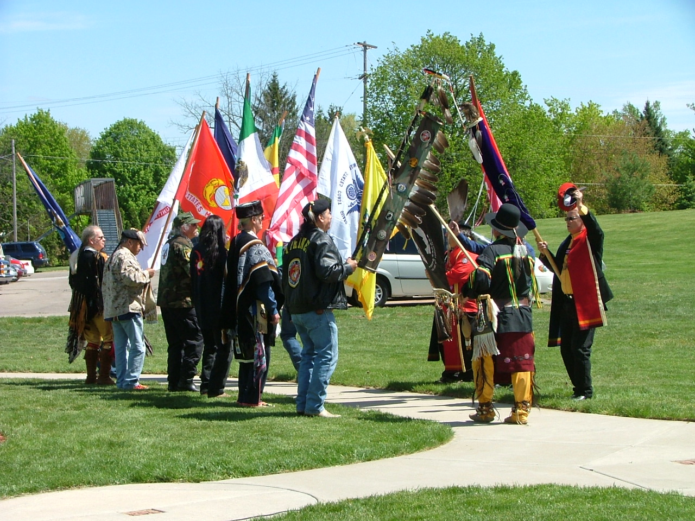
Native American opening ceremony for the Wall that Heals Charlotte, MI May 2008

Slide 9
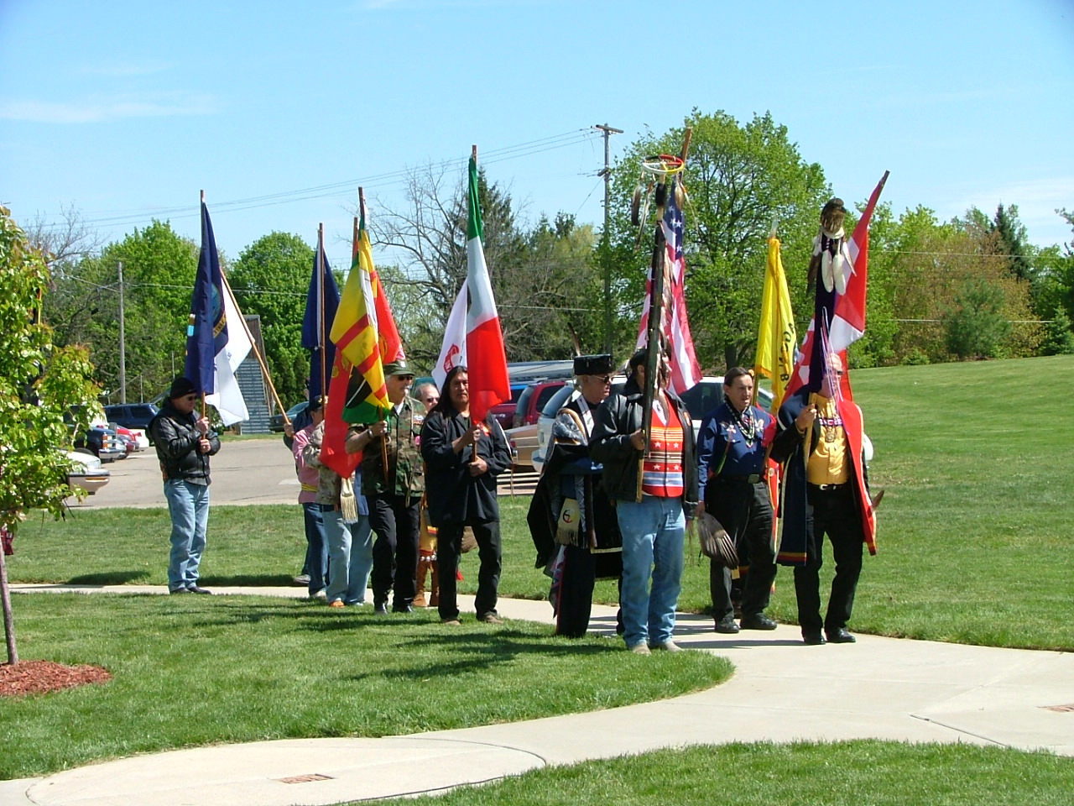
Native American opening ceremony for the Wall that Heals Charlotte, MI May 2008

Slide 10
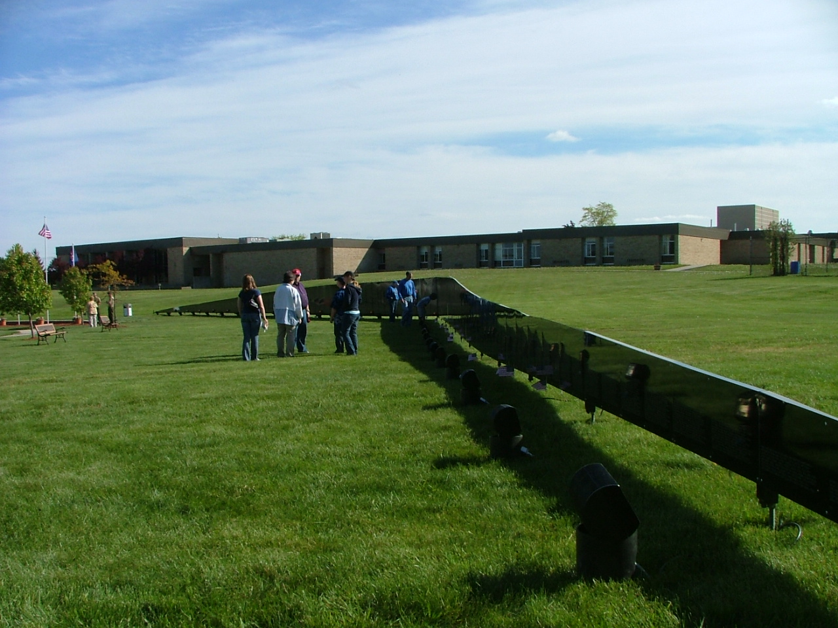
Native American opening ceremony for the Wall that Heals Charlotte, MI May 2008

Slide 11
Native American opening ceremony for the Wall that Heals Charlotte, MI May 2008

Slide 12
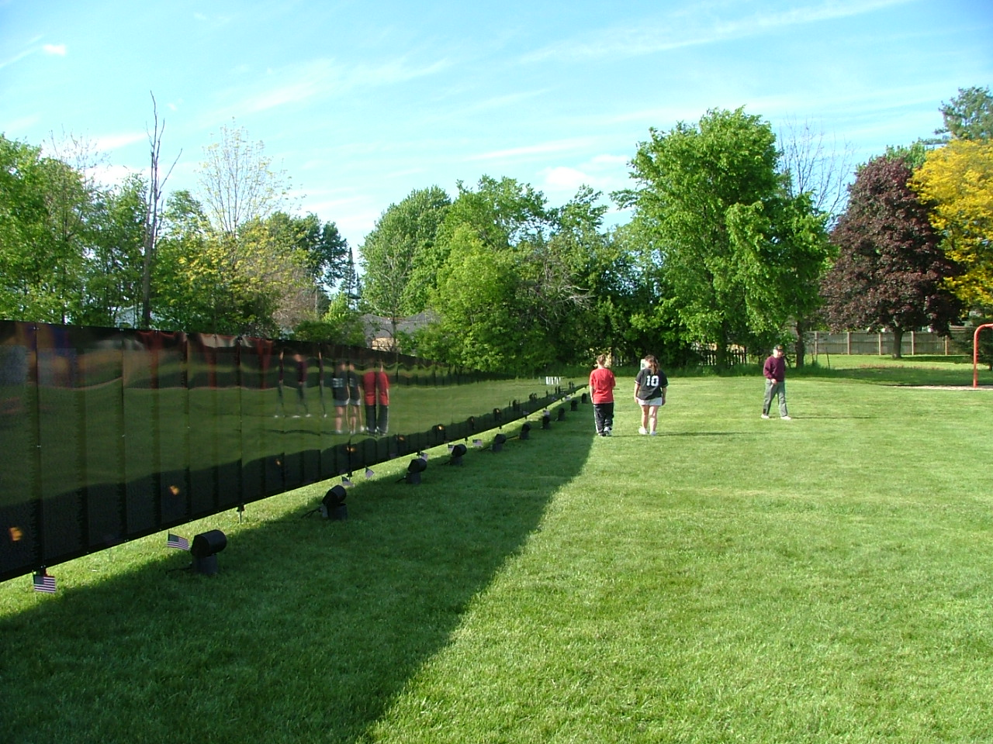
Native American opening ceremony for the Wall that Heals Charlotte, MI May 2008

Slide 13
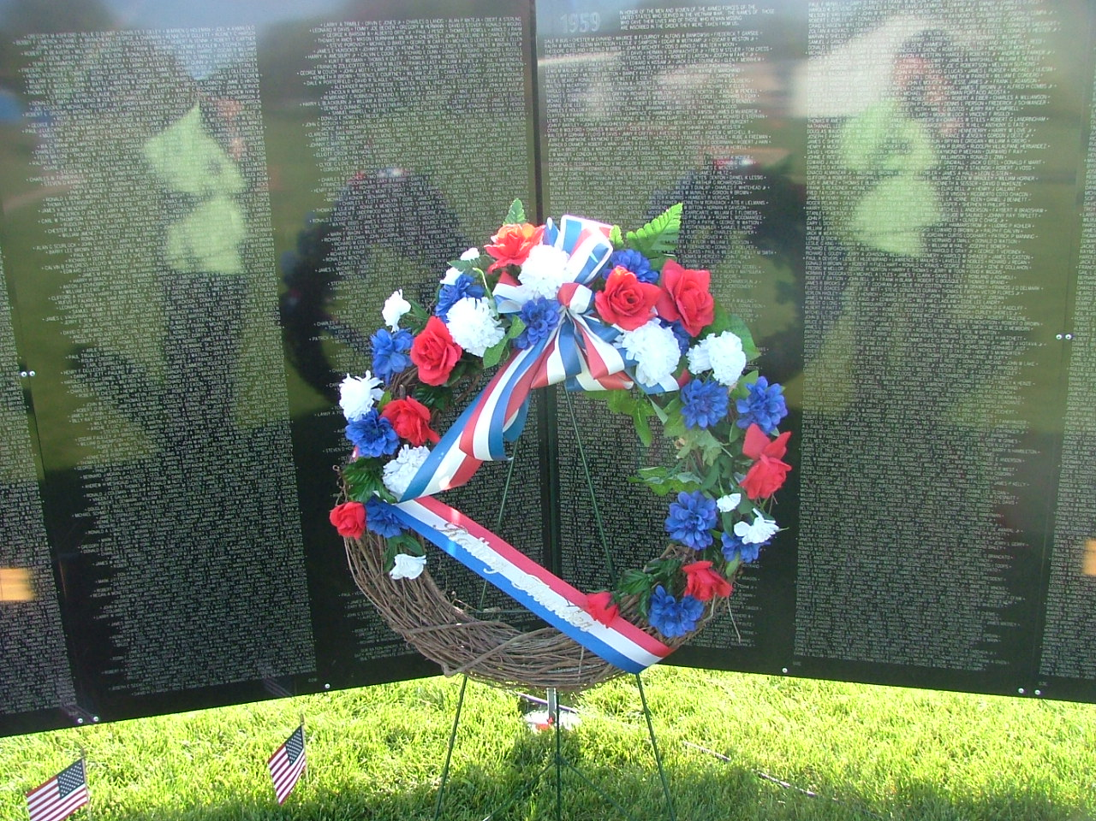
Native American opening ceremony for the Wall that Heals Charlotte, MI May 2008

Slide 14
Native American opening ceremony for the Wall that Heals Charlotte, MI May 2008
As Native American Culture dictates, my photographer was given permission to take pictures and share with the public.
Also, as Native American culture dictates the area where the Wall that Heals was placed was smudged by one of my Native American Vietnam Veterans prior to the Wall’s arrival to relieve the ground of negative energy from playground fights and disputes and other such incidents before it could be placed on what would be considered sacred ground by the Native Americans. The ground would be smudged again after the Wall’s exit to provide for a release of the grief and sorrow left there by the visitors. Both smudgings were privately done with just my veteran and I in attendance. The next picture is the ground that was healed by the smudging.

Slide 15
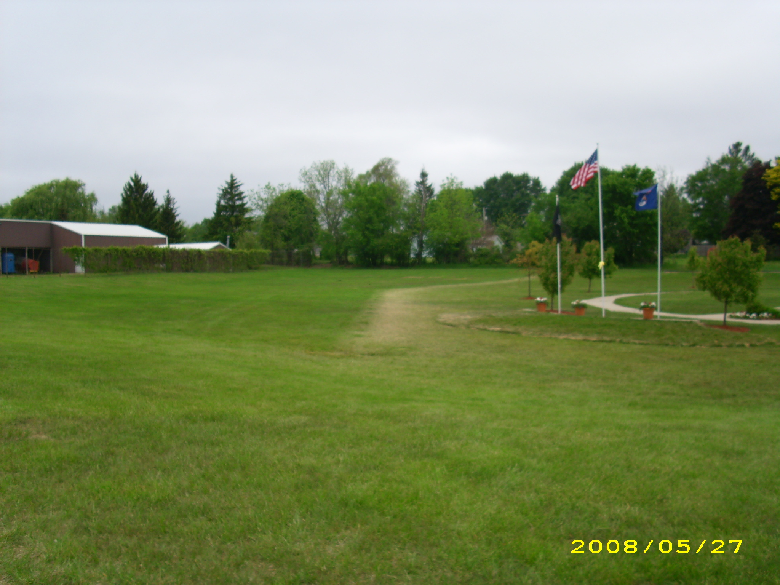
Native American opening ceremony for the Wall that Heals Charlotte, MI May 2008

Slide 16
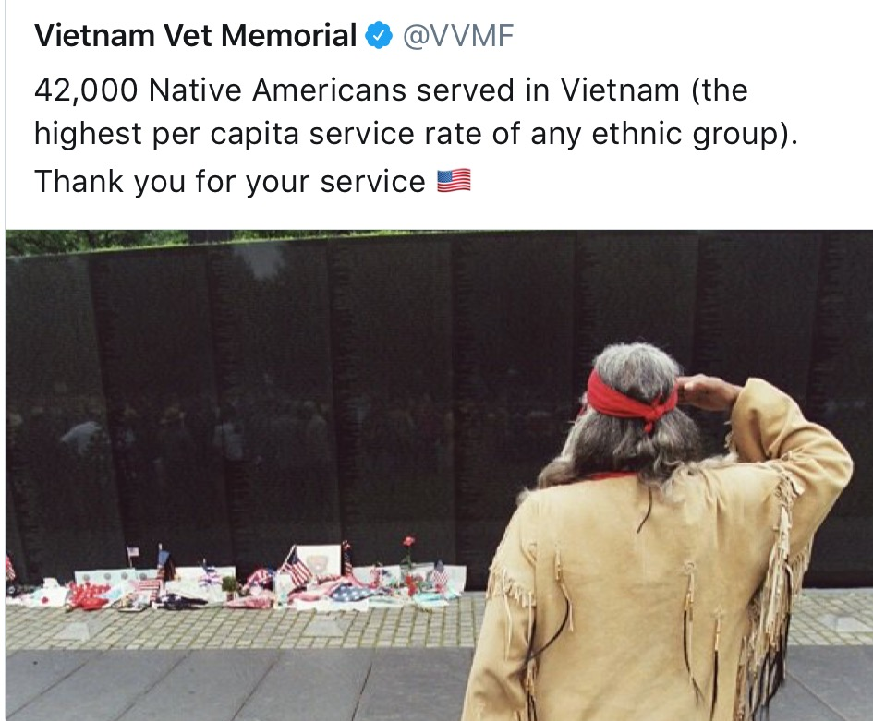
Native American opening ceremony for the Wall that Heals Charlotte, MI May 2008

