Slide 1
You can have a career
In welding

Slide 2
This is my friend nick, I have known him since he was born
He is now the head welder for Detroit bikes

Slide 3
Article on the Detroit robo cop commemoration
https://www.freep.com/story/entertainment/movies/julie-hinds/2020/01/14/robocop-statue-detroit/4456086002/

Slide 4
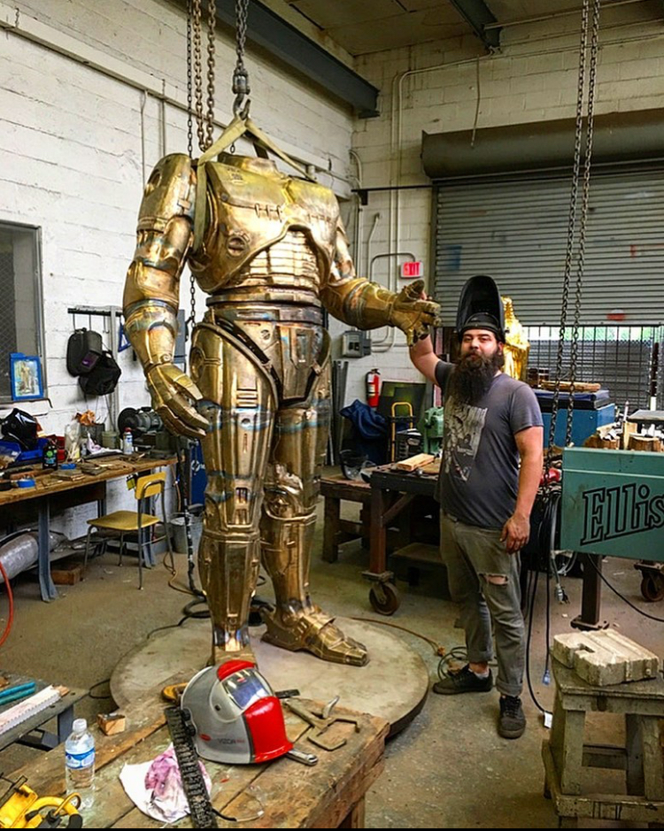
Nick welding on the robo cop statue

Slide 5
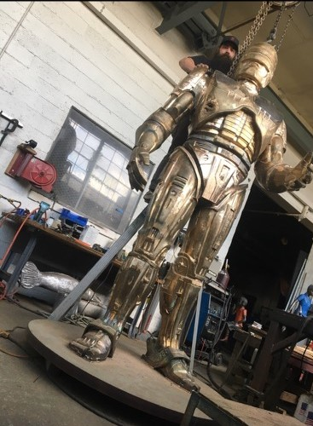
Nick welding on the robo cop statue

Slide 6
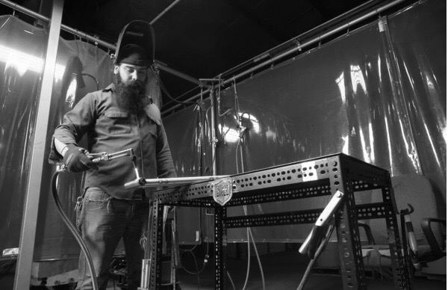
Nick welding for Detroit bikes

Slide 7
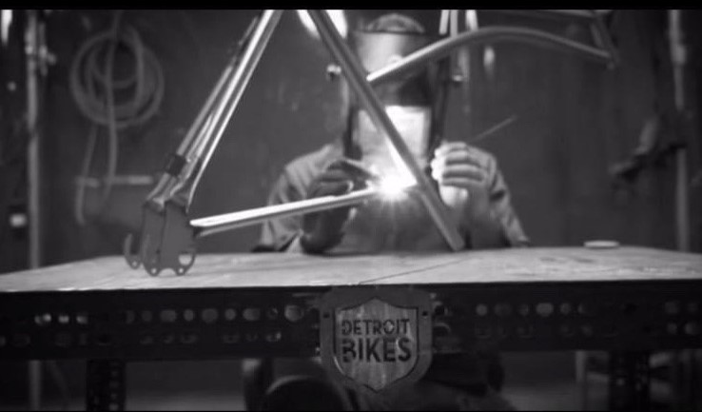
Nick welding for Detroit bikes

Slide 8
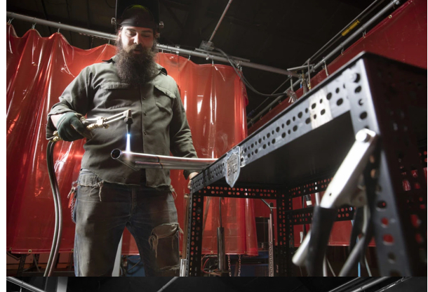
Nick welding for Detroit bikes

Slide 9
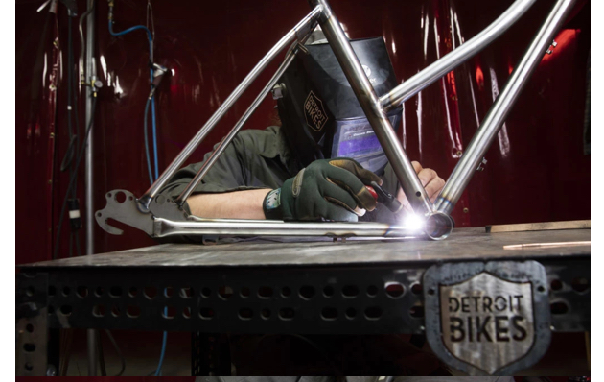
Nick welding for Detroit bikes

Slide 10
Nick is featured in this video 24 seconds in
https://www.youtube.com/watch?app=desktop&v=_BSCDvWpo3c&feature=youtu.be

Slide 11
Nick is featured in this video 1:42 in
https://www.youtube.com/watch?v=2Q9jfRyevxA&feature=youtu.be

Slide 12
https://destinationscanner.com/is-welding-a-good-career/
Sooner or later our country will have to fix its crumbling infrastructure
That means roads, bridges, water pipes, etc.
Baby Boomers are retiring….Are you ready to take their place and earn a good life???

Slide 13
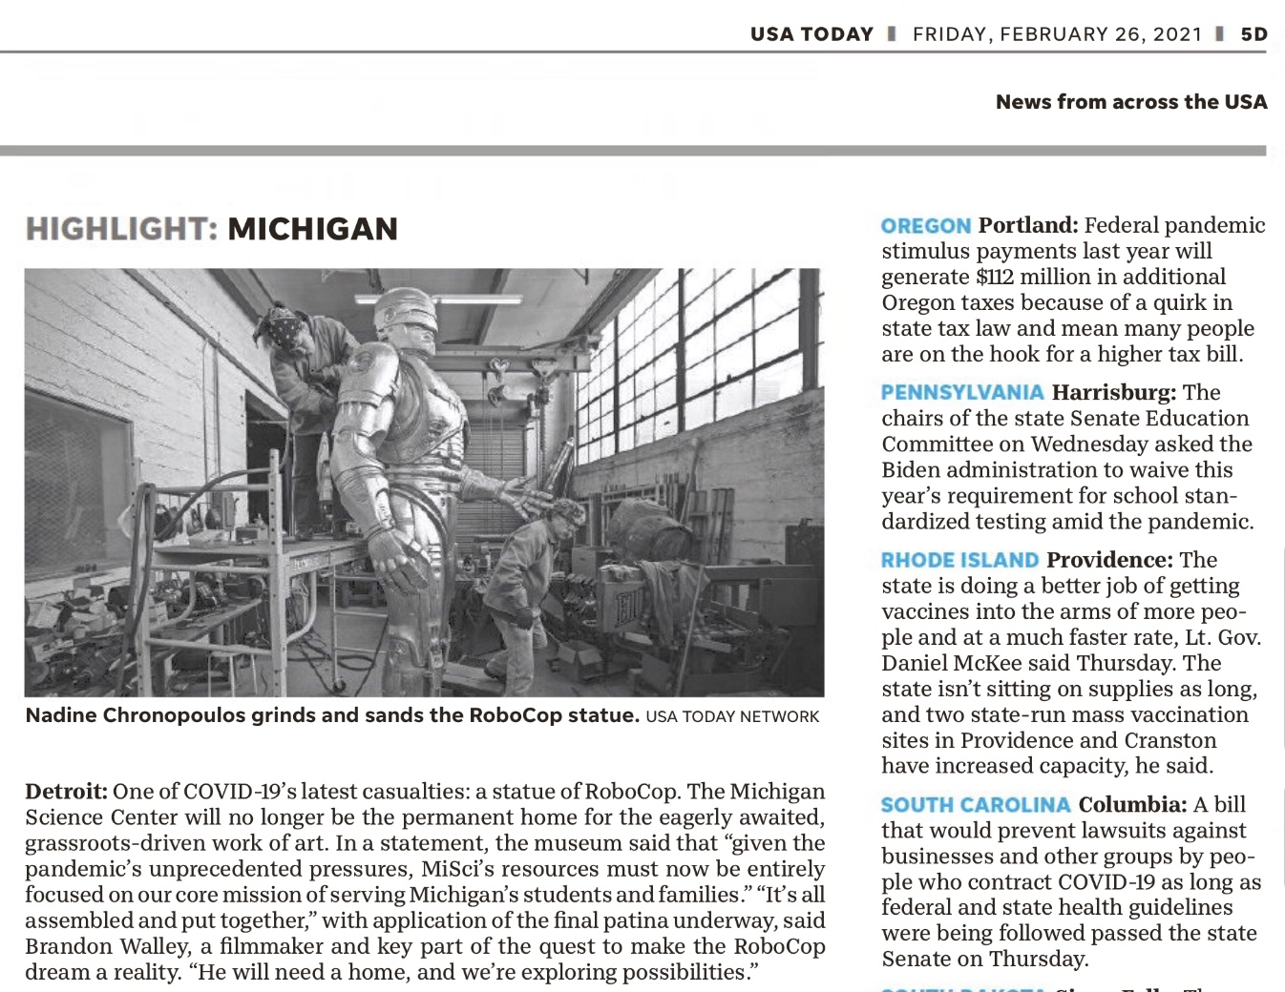
Robo Cop statue makes National News

Slide 15
Article about Robo Cop statue
https://www.metrotimes.com/detroit/robocop/Content?oid=26514744
February 24, 2021

Slide 16
Go to my weebly and look for Unit #7 for information on the trades
http://johnniemossocialstudiesemporium.weebly.com/economics-of-personal-finance.html

